Slide 1
CAPTCHA: Securing the Digital World
Names | Supervisor
Abdulazeez Qusay
Mustafa Musab
Ibrahim Qahtan
Kozhin Kamal
Chewan Jalal

Slide 2






Outline
What is CAPTCHA?
Challenges and Innovations in CAPTCHA
Why CAPTCHA is Important?
Future of CAPTCHA
Types of CAPTCHA
CAPTCHA -Text Type- Python Code

Slide 3

What is CAPTCHA?
CAPTCHA stands for Completely Automated Public Turing test to tell Computers and Humans Apart.
Key Point: CAPTCHA prevents bots from misusing online services by challenging them with tasks humans can solve but bots cannot.

Slide 4

History of CAPTCHA
2000 | CAPTCHA concept introduced by Carnegie Mellon.
2009 | Google acquired reCAPTCHA.
2018 | Invisible CAPTCHA (reCAPTCHA v3) launched.

Slide 5


Why CAPTCHA is Important?
Protects against spam submissions, brute force attacks and fake account creation.
Infographic on cyber attacks stopped by CAPTCHA.
over 25% of internet traffic is attributed to malicious bots.

Slide 6






Types of CAPTCHA
Text-based CAPTCHA
reCAPTCHA (v2 & v3)
Image-based CAPTCHA
Behavioral CAPTCHA.
Visual
Audio CAPTCHA

Slide 7
Strengths of CAPTCHA Types
Text-based
Image-based
Simple, quick to implement
Visual, engaging
Audio
reCAPTCHA
Inclusive for the visually impaired
Advanced, user-friendly

Slide 8
Weakness of CAPTCHA Types
1
Text-based Bots are improving at solving
2
Image-based Accessibility issues
3
Audio Can be hard to understand
4
reCAPTCHA Privacy concerns
(data tracking)

Slide 9
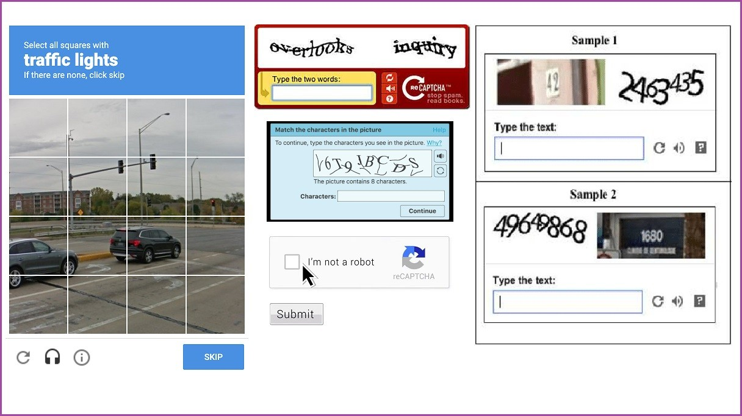
Demonstration of CAPTCHA
Important Questions:
How AI is both solving and improving CAPTCHA?
Statistics: Over 90% of CAPTCHAs can be solved by advanced bots
In short: AI challenges CAPTCHA security while also advancing it to be smarter and more user-friendly

Slide 10
Challenges in CAPTCHA
Accessibility
Bot Advancements
Usability
Difficult for visually/hearing impaired users
AI-driven bots can solve traditional CAPTCHAs
Frustration for users → Increased bounce rates

Slide 11
Innovations in CAPTCHA
Behavioral Analysis
Invisible CAPTCHA
Biometric CAPTCHA
Visual
Monitors mouse movements, click patterns
Users never see it; works behind the scenes
Facial recognition or fingerprint scanning
Show examples of innovative CAPTCHAs

Slide 12
Future of CAPTCHA
AI Integration
Biometric Verification
Smarter CAPTCHAs using AI to detect user behavior and intent
Incorporating facial recognition, fingerprints, or voice IDis actually a cold place
Accessibility Improvements
Invisible CAPTCHA
More inclusive designs for visually and hearing-impaired users
Fully hidden tests that evaluate interactions without user input

Slide 13
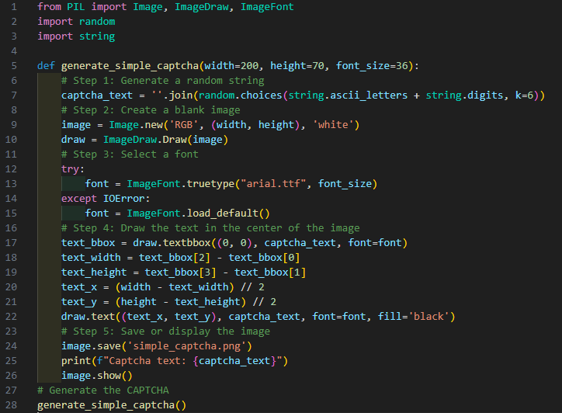
CAPTCHA -Text Type- Python Code

Slide 14
Thanks
Any Question?

